Slide 1

Feelears
Florent Hureaux

Slide 2
Overview of the project :
The goal of the project is to build a device that will be able to play/change a sound automatically based of your emotional state and adapt the sound based on the surrounding noise environment.

Slide 3


Research :
Real-Time Speech Recognition
Real-Time Emotion Detection

Slide 4



Solution :

Slide 5
Features :
Feature from an health app
Emotion-Based Sound Selection
Surrounding Noise Adaptation
User Profiles and Preferences

Slide 6


Technology used :

Slide 7
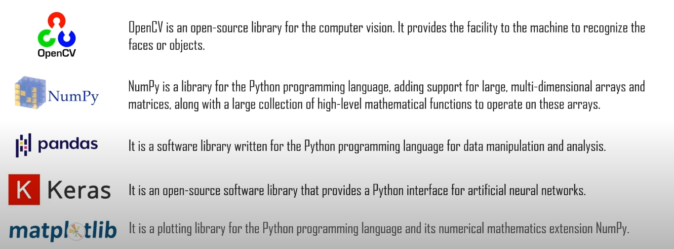
Library used in Google Collab :

Slide 8
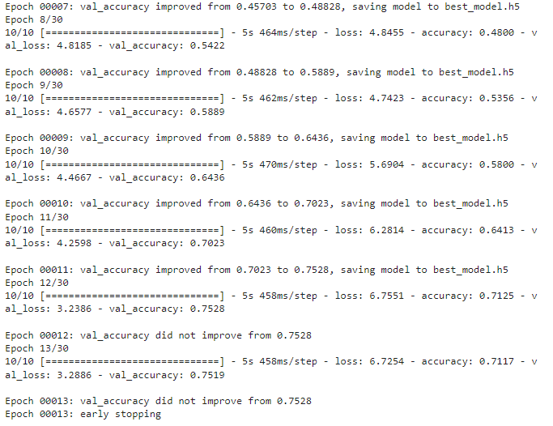
Model trained for facial recognition
13 epochs
~ 71% accuracy of the model
Low dataset

Slide 9
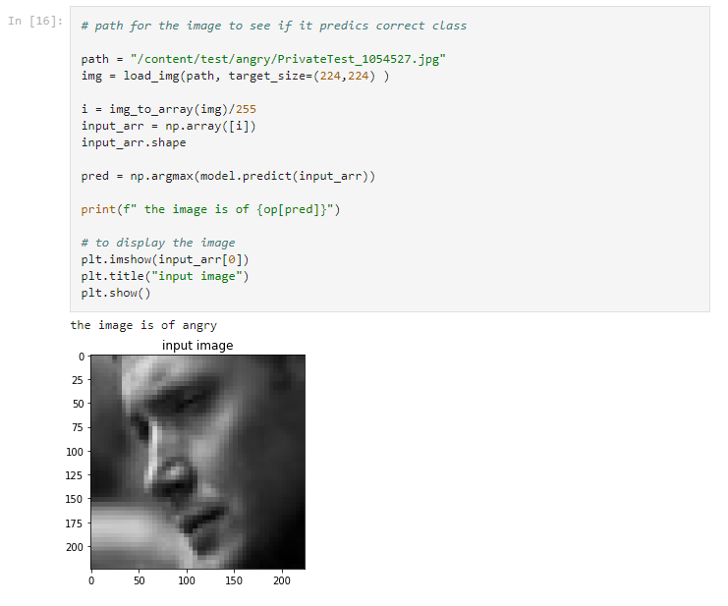
Test of the model directly in Google Collab

Slide 10
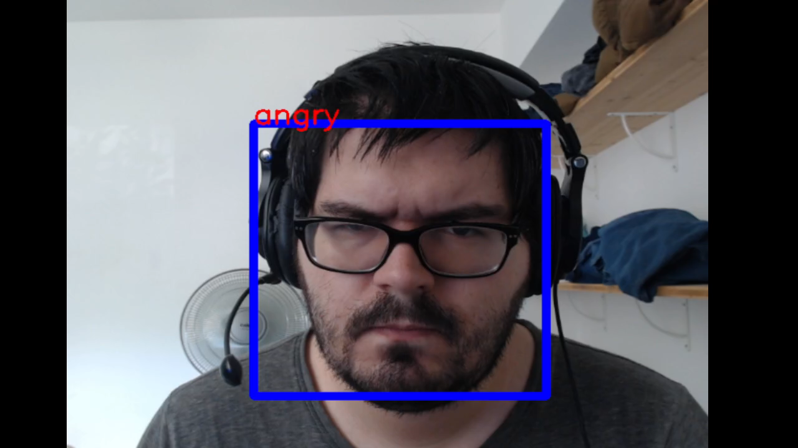

Slide 11

Next step :
Create 3D model
Finish functional specification
Create the template of the application

Slide 12
Thanks for listening !

